Slide 1

STRATEGIC MARKETING MANAGEMENT
IN HEALTHCARE MARKET

Slide 2
1. Define Interfaces between Product Management
And the Rest of the Company
  Product manager’s perspective role
  Sales manager’s perspective role
  Interface Between Product Manager and The Other Department

Slide 3
Marketing Task | Commentary
Identify target markets | Management have to identify those customers with whom they want to trade. The choice of target markets will be influenced by the wealth consumers hold and the business' ability to serve them
Market research | Management have to collect information on the current and potential needs of customers in the markets they have chosen to supply. Areas to research include how customers buy (which marketing channels are used) and what competitors are offering
Product development | Businesses must develop products and services that meet needs and wants sufficiently to attract target customers to wish and buy
Marketing mix | Having identified the target markets and developed relevant products, management must then determine the price, promotion and distribution for the product. The marketing mix is tailored to offer value to customers, to communicate the offer and to make it accessible and convenient
Market monitoring | The objective in marketing is to first attract customers - and then (most importantly) retain them by building a relationship. In order to do this effectively, they need feedback on customer satisfaction. They also need to feed this back into product design and marketing mix as customer needs and the competitive environment changes

Slide 4
SALES MANAGEMENT ROLE AND SALES PROCESS
Engage prospect, assess need and qualify
Determine urgency and next steps w/prospect
Identify buyer, decision maker, and influencers
Inform lead of company’s offer, establish credibility
Gather details of need and budget
Handle and overcome objections
Secure credit approval
Obtain signatures
…PROSPECTING
Identify
Qualify
Propose
Close
Assess competition
Determined recommended solution
Develop and present proposal\bid
Marketing
Networking
Outbound Activity
SALE!
Thank the prospect
Product Support
Referral Program
Up sell
SERVICE!

Slide 5
Interfaces between Product Management and the Rest of the Company
Share Holders Interests
Share
holders
Business
Market
Value
Distribution
Dept
Sales
Dept
Purchasing
Scientific
Training
Dept
Business
Sources
of Growth
Business
Growth
PRODUCT
MANAGER
ROLE
SHARE
HOLDERS
Human
Resources
Business
Dev.
Dept.
Business
Profitability
Business
Market
Share
Finance
Manu-
facturing

Slide 8
2. Management Process

Slide 9
MANAGEMENT PROCESS
EVALUATING
PLANNING
CONTROLING
ORGANIZING
ACTION

Slide 10
3. STRATEGIC ANALYSIS
STRATEGIC
ANALYSIS
STRATEGIC
CHOICE
STRATEGIC
IMPLEMENTATION

Slide 11
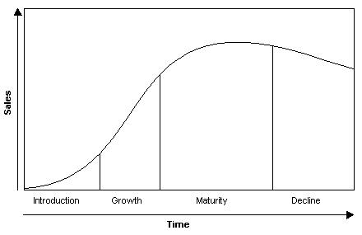
PRODUCT LIFE CYCLE
The Product Life Cycle (PLC)
is based upon the biological life cycle
For example, a seed is planted (introduction);
it begins to sprout (growth); it shoots\
out leaves and puts down roots as it becomes an adult (maturity); after a long period
as an adult the plant begins to shrink and die out (decline).
Problems with Product Life Cycle
In reality very few products follow such a prescriptive cycle. The length of each stage varies enormously The decisions of marketers can change the stage, for example from maturity to decline by price-cutting. Not all products go through each stage. Some go from introduction to decline. It is not easy to tell which stage the product is in. Remember that PLC is like all other tools. Use it to inform your gut feeling.

Slide 12
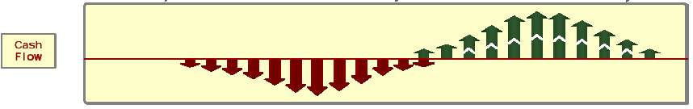

Slide 13
Characteristic of Life Cycle Stages

Slide 15
Introduction
The need for immediate profit is not a pressure. The product is promoted to create awareness. If the product has no or few competitors, a skimming price strategy is employed. Limited numbers of product are available in few channels of distribution.
Growth
Competitors are attracted into the market with very similar offerings. Products become more profitable and companies form alliances, joint ventures and take each other over. Advertising spend is high and focuses upon building brand. Market share tends to stabilize.
Maturity
Those products that survive the earlier stages tend to spend longest in this phase. Sales grow at a decreasing rate and then stabilise. Producers attempt to differentiate products and brands are key to this. Price wars and intense competition occur. At this point the market reaches saturation. Producers begin to leave the market due to poor margins. Promotion becomes more widespread and use a greater variety of media.
Decline
At this point there is a downturn in the market. For example more innovative products are introduced or consumer tastes have changed. There is intense price-cutting and many more products are withdrawn from the market. Profits can be improved by reducing marketing spend and cost cutting.

Slide 16
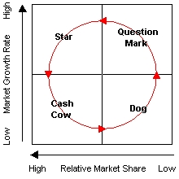
The Boston Matrix - Product Portfolio Decisions
It was developed by the large US consulting group and is an approach to product portfolio planning. It has two controlling aspect namely relative market share (meaning relative to your competition) and market growth.
You would look at each individual product in your range (or portfolio) and place it onto the matrix. You would do this for every product in the range. You can then plot the products of your rivals to give relative market share.

Slide 17
Relative Market Share
H
L
?
Intensify
Marketing
Efforts to
Increase
Share
Intensify
Marketing
Efforts
or Leave
Market
H
Industry
Growth
Rate
Use Profits to
Aid Growing SBUs,
Maintain Position
Reduce Efforts
or Divest
L

Slide 18
Problem Children/Question Mark
These are products with a low share of a high growth market. They consume resources and generate little in return. They absorb most money as you attempt to increase market share
Stars
These are products that are in high growth markets with a relatively high share of that market. Stars tend to generate high amounts of income. Keep and build your stars.
Dogs
These are products with a low share of a low growth market. These are the canine version of 'real turkeys!'. They do not generate cash for the company, they tend to absorb it. Get rid of these products.
Cash Cows
These are products with a high share of a slow growth market. Cash Cows generate more more than is invested in them. So keep them in your portfolio of products for the time being
Look for some kind of balance within your portfolio. Try not to have any Dogs. Cash Cows, Problem Children and Stars need to be kept in a kind of equilibrium. The funds generated by your Cash Cows is used to turn problem children into Stars, which may eventually become Cash Cows. Some of the Problem Children will become Dogs, and this means that you will need a larger contribution from the successful products to compensate for the failures.

Slide 19
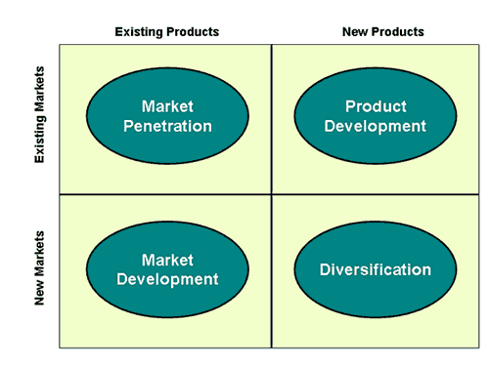
Ansoff's Matrix
This well known marketing tool was first published in the Harvard Business Review
(1957) in an article called 'Strategies for Diversification'
It is used by marketers who have objectives for growth. Ansoff's matrix offers strategic choices to achieve the objectives.
There are four main categories for
selection.
Ansoff's matrix is one of the most well know frameworks for deciding upon strategies for growth.

Slide 20
Market Penetration Strategy
Increase Sales and Market Share in existing
market segment with existing products
Example of Tactics :
  Doubling Call Frequency on A Class Doctors
  More Audio Video Meeting with Specialist
  Goods on Consignment to pharmacies

Slide 21
Market Development Strategy
Increase sales in new markets with existing
Products.
Examples of Tactics:
Promote to another group ( From GP to Specialist)
New Indications to new group of patients
Rx to OTC or OTC to Rx

Slide 22
Product Development Strategy
Introducing New or improved products, line extensions to an existing market segment.
Examples of Tactics :
Develop new products features to offer new benefits
or minimise/eradicate existing products problems
Create higher quality version of existing product
Modifying pack sizes

Slide 23
Diversification
Entering new market with complete new product.
Example of tactics :
New products in a new therapeutic class area
New product line in a related or non pharma related
industry

Slide 24
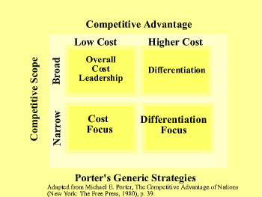
Generic Strategies - Michael Porter
Generic strategies were used initially in the early 1980s, and seem to be even more popular today.
They outline the three main strategic options open to organization that wish to achieve a sustainable competitive advantage.
Each of the three options are considered within the context of two aspects of the competitive environment:
The generic strategies are:
Cost leadership,
Differentiation,
Focus

Slide 25
1. Cost Leadership
The low cost leader in any market gains competitive advantage from being able to many to produce at the lowest cost. Factories are built and maintained, labor is recruited and trained to deliver the lowest possible costs of production. 'cost advantage' is the focus. Costs are shaved off every element of the value chain. Products tend to be 'no frills.' However, low cost does not always lead to low price. Producers could price at competitive parity, exploiting the benefits of a bigger margin than competitors. Some organization, such as Toyota, are very good not only at producing high quality autos at a low price, but have the brand and marketing skills to use a premium pricing policy.
2. Differentiation
Differentiated goods and services satisfy the needs of customers through a sustainable competitive advantage. This allows companies to desensitize prices and focus on value that generates a comparatively higher price and a better margin. The benefits of differentiation require producers to segment markets in order to target goods and services at specific segments, generating a higher than average price. For example, British Airways differentiates its service. The differentiating organization will incur additional costs in creating their competitive advantage. These costs must be offset by the increase in revenue generated by sales. Costs must be recovered. There is also the chance that any differentiation could be copied by competitors. Therefore there is always an incentive to innovated and continuously improve

Slide 26
3. Focus or Niche strategy
The focus strategy is also known as a 'niche' strategy. Where an organization can afford neither a wide scope cost leadership nor a wide scope differentiation strategy, a niche strategy could be more suitable. Here an organization focuses effort and resources on a narrow, defined segment of a market. Competitive advantage is generated specifically for the niche. A niche strategy is often used by smaller firms. A company could use either a cost focus or a differentiation focus. With a cost focus a firm aims at being the lowest cost producer in that niche or segment. With a differentiation focus a firm creates competitive advantage through differentiation within the niche or segment. There are potentially problems with the niche approach. Small, specialist niches could disappear in the long term. Cost focus is unachievable with an industry depending upon economies of scale e.g. telecommunications.

Slide 27
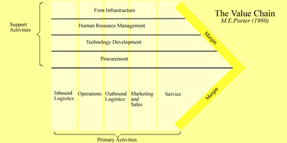
Value Chain Analysis
The value chain is a systematic approach to examining the development of competitive advantage.
It was created by M. E. Porter in his book, Competitive Advantage (1980).
The chain consists of a series of activities that create and build value.
They culminate in the total value delivered by an organization.
The 'margin' depicted in the diagram is the same as added value.
The organization is split into 'primary activities' and 'support activities.

Slide 28
Primary Activities
Inbound Logistics
Here goods are received from a company's suppliers. They are stored until they are needed on the production/assembly line. Goods are moved around the organization.
Operations
This is where goods are manufactured or assembled. Individual operations could include room service in an hotel, packing of books/videos/games by an online retailer, or the final tune for a new car's engine.
Outbound Logistics
The goods are now finished, and they need to be sent along the supply chain to wholesalers, retailers or the final consumer.
Marketing and Sales
In true customer orientated fashion, at this stage the organization prepares the offering to meet the needs of targeted customers. This area focuses strongly upon marketing communications and the promotions mix.
Service
This includes all areas of service such as installation, after-sales service, complaints handling, training and so on.

Slide 29
Support Activities
Procurement
This function is responsible for all purchasing of goods, services and materials. The aim is to secure the lowest possible price for purchases of the highest possible quality. They will be responsible for outsourcing (components or operations that would normally be done in-house are done by other organizations), and e-Purchasing (using IT and web-based technologies to achieve procurement aims).
Technology Development
Technology is an important source of competitive advantage. Companies need to innovate to reduce costs and to protect and sustain competitive advantage. This could include production technology, Internet marketing activities, lean manufacturing, Customer Relationship Management (CRM), and many other technological developments.
Human Resource Management (HRM)
Employees are an expensive and vital resource. An organization would manage recruitment and selection, training and development, and rewards and remuneration. The mission and objectives of the organization would be driving force behind the HRM strategy.
Firm Infrastructure
This activity includes and is driven by corporate or strategic planning. It includes the Management Information System (MIS), and other mechanisms for planning and control such as the accounting department.

Slide 30
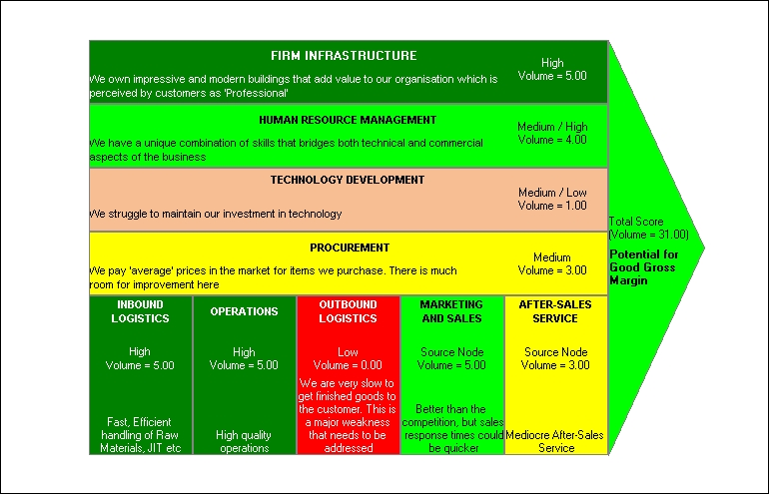

Slide 31
4. PREPARING MARKETING PLAN

Slide 32
ENVIRONMENTAL ANALYSIS
The organization's Marketing Environment
Internal Environment :
Staff, finance, purchasing etc
Industry Environment :
Customers, supplier, competitors ec
Macro Environment :
Politic, Economic, Sociocultural, Technology
forces

Slide 33
PEST Analysis
Political
PEST analysis :
Very important that an organization
considers its environment before
beginning the marketing process.
Environmental analysis should be
continuous and feed all aspects of
planning
Techno
logy
Opportunity
Threat
Economic
Socio
cultural

Slide 34
Political Factors
The political arena has a huge influence upon:
the regulation of businesses
the spending power of consumers and other businesses.
You must consider issues such as:
1. How stable is the political environment?
2. Will government policy influence laws that regulate or tax your business?
3. What is the government's position on marketing ethics?
4. What is the government's policy on the economy and health spending?
5. Does the government have a view on culture and religion?
6. Is the government involved in trading agreements such as WTO, EU, NAFTA,AFTA,
Asian Harmonization or others?

Slide 35
Economic Factors
Marketers need to consider the state of a trading economy in the short and long-terms. This is especially true when planning for international marketing.
You need to look at:
1. Interest rates and currency rate
2. The level of inflation Employment level per capita
3. Long-term prospects for the economy Gross Domestic Product (GDP) per
capita, and so on

Slide 36
Socio Cultural Factors
The social and cultural influences on business vary from country to country. It is very important that such factors are considered. Factors include:
1. What is the dominant religion?
2. What are attitudes to foreign products and services?
3. Does language impact upon the diffusion of products onto
markets?
4. How much time do consumers have for leisure?
5. What are the roles of men and women within society?
6. How long are the population living? Are the older generations
wealthy?

Slide 37
Technological Factors
Technology is vital for competitive advantage, and is a major driver of globalization. Consider the following points:
Does technology allow for products and services to be made more cheaply and to a better standard of quality?
2. Do the technologies offer consumers and businesses more innovative products and services such as , cancer vaccines, slow release drugs, Internet banking, new generation mobile telephones, etc?
3. How is distribution changed by new technologies e.g. drugs via the Internet, flight tickets, auctions, etc?
4. Does technology offer companies a new way to communicate with consumers e.g. banners, Customer Relationship Management (CRM), etc?

Slide 38
COMPETITOR ANALYSIS
Who is my competitor?
Actual
Potential
Direct
Indirect
Drug Composition/Ingredient
Indication
Therapeutic Class
Drug Generation
Drug Preparation

Slide 39
COMPETITOR ANALYSIS
STRENGTH
WEAKNESSES
Capabilities
PRODUCT
POSITIONING
Strategy
PRODUCT PORTFOLIO
MARKET SHARE
Objectives
SALES GROWTH

Slide 40
SALES GROWTH
PERIODIC : MONTHLY or QUARTERLY or ANNUALY
%GR = (V(t) - V(t-1))/(V(t-1))
Compound Annual Growth Rate
%GR = (V(t) - V(t-1))/(V(t-1))

Slide 41
MARKET SHARE ANALYSIS
Market share is product sales share to total value based on:
    Total Industry
    Therapeutic Class
    Drug Generation
    Drug Preparation
    Foreign Vs Local
    By Country Origin
By Value
Trend
Market
Share
By Unit
% Absolute

Slide 42
Competitor Positioning Analysis
The strategies, tactics, messages, and creative are all directly dependent upon the development of appropriate positioning.
Positioning is all about 'perception'
As perception differs from person to person, so do the results of the positioning map e.g
what you perceive as quality, value for money, etc, is different to my perception.
There will be similarities between brand positioning
Products or services are 'mapped' together on a 'positioning map‘
Marketers decide upon a competitive position which enables them to distinguish their own products from
the offerings of their competition (hence the term 'positioning strategy').
Brand Positioning development:
      Professional Positioning
      Patient Positioning
      Global Positioning

Slide 43
Positioning Variable in Pharmaceutical Industry
Efficacy
Drug
Delivery
System
Dosage
Positioning
Variable
Cost
Therapy
Side
Effect
Therapeutic
Class
Mechanism
of Action

Slide 44
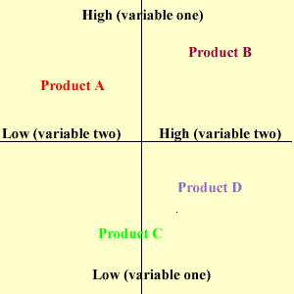
COMPETITION POSITIONING MAP

Slide 45
COMPETITOR PRODUCT PORTFOLIO ANALYSIS
Business
Units
Business
Line
Portfolio
Drug
Preparation
Therapeutic
Class

Slide 46
COMPETITOR PORTFOLIO MAPPING
COMPANY | Variables
 | Business Unit
 | A |  |  |  | B |  |  |  |  | C
 | Line
 | A1 |  | A2 |  | B1 |  | B2 |  | C1 |  | C2
 | Therapeutic Class |  | Therapeutic Class |  | Therapeutic Class |  | Therapeutic Class |  | Therapeutic Class |  | Therapeutic Class
 | TC1 | TC2 | TC3 | TC4 | TC5 | TC6 | TC7 | TC8 | TC9 | TC10 | TC11 | TC12
Company 1
Company 2
Company 3
Company 4
Company 5
Company 6

Slide 47
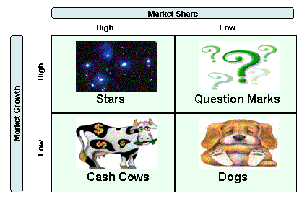
COMPETITOR PRODUCT PORTFOLIO ANALYSIS
BCG ANALYSIS

Slide 48
COMPETITOR PRODUCT PORTFOLIO ANALYSIS PRODUCT LIFE CYCLE ANALYSIS

Slide 49
CRITICAL SUCCESS FACTOR
PRICE
BUSINESS
PROCESS
PRO
DUCT
TECHNO
LOGY
PROMO
TION
CSF
CUSTO
MER
DISTRI
BUTION
PORT
FOLIO
PEOPLE

Slide 50
INTERNAL ANALYSIS
PRODUCT LINE
Product Line – Therapeutic Generation
Product Line internal market share
Product Line Profitability
BCG analysis
Product Life Cycle

Slide 51
COMPANY IMAGE
Research and Development
Manufacturing Facilities –Standard
Therapeutic Area Strength
Scientific and Clinical Data
Customer Services Process
Information and Technology Application

Slide 52
PRODUCT ANALYSIS
Clinical
Research
Brand
Mapping
Drug
Delivery
System
CSF
Positioning
Feature
and
Benefits
Key
Selling
Point
Product
Value
Propositions

Slide 53
SWOT ANALYSIS
Who are my competitors?
How do I analyze them?
SWOT analysis and SWOT Matrix
A SWOT analysis helps you match your company’s resources and capabilities to threats and opportunities in the competitive environment.
SWOT analysis can be very subjective, but adding weighting and criteria to each factor increases the validity of the analysis. Also completing the SWOT matrix can help you pick the best strategy to implement.
A SWOT analysis is technique all elements to arrive at a strategy tactics and objectives

Slide 54
SWOT ANALYSIS
Strengths
Company
Category Product
Product
Weaknesses
Country
Area
Market
Therapeutic Class
Opportunities
Threats

Slide 55
SWOT MATRIX
Strength
Weakness
Opportunities
Strength-Opportunity strategies
Weakness-Opportunity strategies
Threats
Strength-Threat strategies
Weakness-Threat strategies

Slide 56
Why use SWOT analysis?
Methodically and honestly assessing your company’s strengths and weaknesses as well as the opportunities and threats it faces gives you a rare opportunity for objective analysis. The SWOT technique:
  is easy to use
  combines quantitative and qualitative analysis
  encourages interdepartmental collaboration
To make sure your analysis is put to good use, include these
before and after steps in your analysis:
  Set an objective for the analysis
  Assemble a diverse project team that includes specialists and idea
  people
  Set aside adequate time for research and information-gathering
  Evaluate the results of your analysis against your original objective

Slide 57
Assessing your strengths
The first two elements of your analysis focus on internal capabilities. Strengths can come from many sources, including your team members, your product line, your bank account, your production process, your patents, or your market share. To jump start your list of strengths, ask questions in these categories.
Products
  What relevant resources does the company have, such as patents,
  proprietary software, distribution channels, production systems?
  Does the company manage its inventories efficiently?
  Does the company have strong brands?
  What is the market share of the company in its various product lines?
People
  Does the company have a strong team of skilled employees?
  Are there employees with skills unique in the industry?
Performance
  What does the company do well?
  What do other people see as the company’s strengths?
  What are the major sources of a company's revenue and profit?
  Has the company demonstrated the ability to adapt and change?
  Are the marketing and advertising programs effective?
  Does the company use information technology effectively?

Slide 58
Assessing your weaknesses
Don’t let this part of the process turn into an unpleasant session of finger pointing. Focus on the root causes of long-standing problems, not individual mistakes or failures. Consider these questions when assessing your weaknesses:
Products
  What are the least profitable product lines for the company?
  What products or services do competitors offer that you don’t?
  Is the product line lacking in any market segment?
People
  Does your company provide good customer service?
  Do team members lack vital skills?
  How strong are the communication skills of team members and team leaders?
Performance
  What does the company do poorly or not at all?
  Has the company brought new ideas and products to the market place?
  Is the company losing out to competitors on the technology front?
  What objections do potential clients or customers frequently raise?
  Are production processes ineffective or outdated?

Slide 59
Assessing your opportunities
This part of your analysis reviews external forces, including socioeconomic, political, environmental and demographic changes that could effect your company. Consider these questions when reviewing your opportunities.
Products
  What new needs of customers could the company meet?
  What niches have competitors missed?
  Does the company’s product line have any holes in it?
  Can poor-performing product lines be discontinued to boost profitability?
  Is there an opportunity to demand better prices from suppliers?
  Are there opportunities to extend brands into related areas?
Performance
  What are the emerging political and social opportunities?
  Is there new technology that could help the business?
  Are there inexpensive acquisition opportunities?
  Are there new economic trends that benefit the company?
People
  Can you start incentive plans to boost employee performance?
  Are there training programs that would improve employees’ skills?

Slide 60
Assessing your threats
Threats can be hard to define, so this portion of the analysis can be the most difficult and the most illuminating, both in terms of pointing out what needs to be done, and in putting problems into perspective.
Products
  Are any of the company’s products threatened by a competitor?
  Are any new technologies likely to make one of the company’s products obsolete?
People
  Can the company attract and retain the employees it needs?
  Are there communication problems that often derail new initiatives?
Performance
  What are the negative economic trends?
  What are the negative political and social trends?
  What obstacles does the company face?
  Does the company have bad debt or cash-flow problems?
  Where are competitors about to threaten the company’s position?
.

Slide 61
SWOT ANALYSIS
STRENGTHS Good side effect profile Good Efficacy Good Local and International Trial Program Support from Head Quarter New Chemical Entity Variety of Presentations | WEAKNESSES Company has limited experience here Limited comparative data Seen more as a tranquilizer than as anti emetic Limited Resources
OPPORTUNITIES Medics aware of benzodiazepine problem Market decline halted in tranquilizer segment Premium price acceptable in tranquilizer market Future Product Development Value Growth | THREATHS Strong Competition Dominant Brands in both segments New competitor entry

Slide 62
SWOT ANALYSIS USING WEIGHTED SCORE
STEP1.
From List of O-T or S-W edit list to 5-10 keys factors
STEP2.
Rewrite all negative factors to positive factors
Lift up areas of strengths
STEP3.
Weight The List
Remedial action on weaknesses
STEP4.
Score The Factors and Calculate The Weighted Score
STEP5.
Develop Strategy and Action/Tactics

Slide 63
SCORING SCALE
SCORE | CRITERIA
3 | Best in segment. Maximum. Clearly the Leader. Top Quality
2 | Above average. Better than most. Good Quality
1 | Average. Not current problem. OK
0 | Causes some problems. Could be better. Not Improving
-1 | Among the Worst. Always a problem. Really Bad. Need a lot of attention

Slide 64
FACTORS | WEIGHT (W) | SEGMENT1 - GPs |  | SEGMENT2- specialist
 |  | Score (S) | Weighted Score (WxS) | Score (S) | Weighted Score (WxS)
Opportunities and Threats
High Segment growth rate | 20 | 2 | 40 | 0 | 0
Large Segment size | 15 | 3 | 45 | 2 | 30
High Level of customers interest | 15 | 1 | 15 | 0 | 0
Low level of price sensitivity | 13 | -1 | -13 | 2 | 26
Opening of new hospitals | 12 | 1 | 12 | 2 | 24
Poor marketing skills of competitors | 10 | 1 | 10 | 1 | 10
Few Competitors | 10 | 1 | 10 | 1 | 10
No new products from competitors | 5 | 2 | 10 | 2 | 10
Total | 100 |  | 129 |  | 110

Slide 65
FACTORS | WEIGHT (W) | SEGMENT1 – GPs |  | SEGMENT2- specialist
 |  | Score (S) | Weighted Score (WxS) | Score (S) | Weighted Score (WxS)
Strengths and Weaknesses
Highly effective products | 20 | 1 | 20 | 1 | 20
Convenient Packaging | 15 | 2 | 30 | 2 | 30
High Segment Market Share | 10 | 1 | 10 | 1 | 10
Excellent Distribution | 15 | -1 | -15 | 2 | 30
Good Medical Support | 10 | 1 | 10 | 2 | 20
Effectives Sales Force | 10 | -1 | -10 | 2 | 20
Well Motivated Sales Forces | 10 | 1 | 10 | 1 | 10
Adequate promotion budget | 5 | 1 | 5 | 2 | 10
Excellent company reputation | 5 | -1 | -5 | 2 | 10
Total | 100 |  | 55 |  | 160

Slide 66
DECISION GRID
300
A : Target Area
B : Potential Successful
C : High Risks
B
A
A
200
Opportunities - Threats
C
B
A
100
Specialist Segment
C
C
B
GPs Segment
100
200
300
Strengths - Weaknesses

Slide 67
STRATEGY A
PROMOTE PRODUCTS X N SPECIALIST SEGMENT
ACTION AND TACTICS
    Promotional emphasis on convenient packaging
    Emphasize fast and efficient delivery service to customers
    Establish communication program that product is more effective than competitor
    Increase motivation of sale force through competition or other activity

Slide 68
STRATEGY B
TO BRING ABOUT REMEDIAL PROGRAM AND PREPARE FOR MOVING TOWARD GP PROMOTION IN FOLLOWING YEAR
ACTION AND TACTICS
    To develop distribution facility to handle GPs more effectively
    To commence sales training program for reps to sell to GPs
    Work on PR, communication and educational program to improve company image
    Convince customer of quality of medical support services relative to competition.

Slide 69
Use the SWOT Matrix to pick a strategy
At this point in the analysis, you should have a list of strengths, weaknesses, threats and opportunities. To develop strategies based on this list, use the SWOT matrix. The matrix can help you to match up internal strengths and weaknesses with external threats and opportunities and develop a feasible plan for addressing the strongest forces.
Four strategy types from the SWOT Matrix

Slide 70
 | Strengths List 4-5 internal strengths here | Weaknesses List 4-5 internal weaknesses here
Opportunities List 4-5 external opportunities here | S-O strategies S-O strategies use a firm’s internal strengths to take advantage of external opportunities. These are the best strategies to employ, but many firms are not in a position to do so. Companies will generally pursue one or several of the other three strategies first to be able to apply SO strategies. | W-O strategies Sometimes key external opportunities exist, but a firm has internal weaknesses that prevent it from exploiting those opportunities. W-O strategies aim at improving weaknesses to take advantage of opportunities.
Threats List 4-5 external threats here | S-T strategies S-T strategies use a firm’s strengths to avoid or reduce external threats. This does not mean that a strong organization should always meet threats head-on. A company has to weigh the severity and immediacy of the threat before selecting this kind of strategy. | W-T strategies W-T strategies are defensive tactics designed to reduce weaknesses and avoid threats. A company faced with numerous threats and weaknesses may have to merge, retrench, declare bankruptcy, or close.

Slide 71
SUMMARY
Brain storm to identify SWOT
Better results come with more effort, thinking and judgment
Know reasons for prioritizing and weighting
Use Facts when scoring avoid emotional and “political” decisions
Update SWOT analysis

Slide 72
DEFINING MARKETING OBJECTIVES
SMART objectives
Specific - Be precise about what you are going to achieve
Measurable - Quantify your objectives
Achievable - Are you attempting too much?
Realistic - Do you have the resource to make the objective happen (men, money, machines, materials, minutes)?
Timed - State when you will achieve the objective (within a month? By February 2010?)

Slide 73
DEFINING MARKETING OBJECTIVES
EXAMPLES OF PRODUCT OBJECTIVES
 | SHORT TERM | LONG TERM
FINANCIAL OBJECTIVES | To achieve sales of $500,000 | To achieve yearly sales of
 | and profit $75,000 (15%) in | $1.0 million and profits
 | year 1 | $200,000 (20%) by the end of
 |  | 3rd year
MARKETING OBJECTIVES
 | To reach 5% value share at | To achieve 10% value share
 | the end of year 1 in the anti | in the overall anti emetic
 | emetic market | market by the end of year 3

Slide 74
VARIABLES OF MARKETING AND FINANCIAL OBJECTIVES
% Sales
Growth
Net Sales
Value
% Area
Outlet
Coverage
%Market
Share
% Net
Profit after
Tax
% COGS
Marketing
Objectives
Financial
Objectives
Field Force
Productivity
% Share
Growth
% Operating
Profit
Gross
Profit
Number
New Product
Launch
% Marketing
Expenses

Slide 75
CHUNKING DOWN SALES TARGET
SALES TARGET VALUE
PRICING
UNIT PACK
COUNTING UNIT
DOCTOR SPECIALTY
DOSAGE
INDICATION
DURATION OF THERAPY
PRESCRIPTION TARGET
EXISTING USERS
BY SPECIALTY
NEW USERS
NUMBER OF USER TARGET
BY INDICATION
AREA DEVELOPMENT PLAN

Slide 76
PRODUCT
the broad spectrum of tangible
and intangible benefits that a
buyer might gain from a product
once it has been purchased;
a bundle of benefits
TOTAL
PRODUCT
common
Primary characteristics
salient
designed
Auxiliary characteristics
distinguishing
disconnected

Slide 77
Types of Prescription Drugs
Innovator drug
A drug that receives a patent on its chemical formulation or manufacturing process, and is sold under a brand name
Brand name drug
An innovator drug
Generic drug
A copy of an innovator drug. Contains the same active ingredients and is judged to be comparable in terms of strength, quality and therapeutic effectiveness. Generic drugs may be sold after the patent on a brand name pharmaceutical has expired. Generic drugs are generally sold under their chemical name rather than under a brand name
Breakthrough drug
The first brand name drug to use a particular mechanism or to use a particular method for treating a given disease, e.g. Rhône-Poulenc Rorer’s Rilutek for amyotrophic lateral sclerosis (ALS)
Me-too drug
A brand name drug that uses the same therapeutic mechanism as a breakthrough drug and therefore competes with it directly, e.g. Schering Health Care’s interferon beta drug, Betaferon, used in MS now has two interferon beta rivals in the form of Biogen’s Avonex, and Ares-Serono’s Rebif

Slide 78
Five Levels of a Product
Potential
Augmented
Expected
Generic
Core
Benefit

Slide 79
Product Hierarchy
Need Family
Product Family
Product Class
Product Line
Product Type
Brand
Item/SKU

Slide 80
Product Strategy
1. Plan the product concept & develop a unified mix
of product attributes relative to competitive offerings
2. Define the core idea underlying the product features
and benefits that appeal to the Target Market
3. Differentiate aspects of the product that set it apart
or make it different from competitors’ offerings

Slide 81
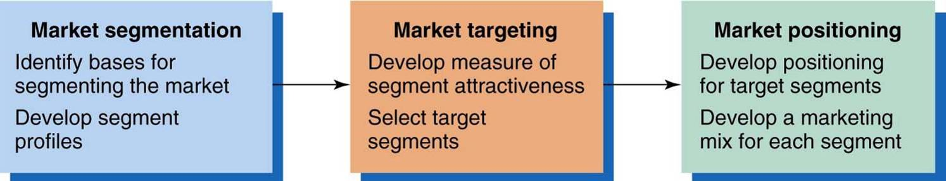
PRODUCT STRATEGY
STRATEGIC
ANALYSIS
STRATEGIC
CHOICE
S
T
P
STRATEGIC
IMPLEMENTATION
PRODUCT STRATEGY STATEMENT

Slide 82
6. Develop Marketing
Mix for Each Target Segment
Market
Positioning
5. Develop Positioning
for Each Target Segment
4. Select Target
Segment(s)
Market
Targeting
3. Develop Measures
of Segment Attractiveness
2. Develop Profiles
of Resulting Segments
1. Identify Bases
for Segmenting the Market
Market Segmentation

Slide 83
MARKET SEGMENTATION
“The process of dividing a market into groups of similar consumers and selecting the most appropriate (profitable) group (s) for the firm to serve.”
Market Segmentation, A Preface to Marketing Management, J. Paul Peter, James H. Donnelly, Jr.

Slide 84
Why Segment?
"Segmentation is often the key to developing a sustainable competitive advantage based on differentiation, low cost, or a focus strategy.”
Not all consumers are equally valuable
Profitability & efficiencies
  Can be limiting
  Economies of scale vs. scope

Slide 85
Measurable
Accessible
Requirements for Effective Segmentation
Substantial
Size, purchasing power, profiles
of segments can be measured.
Differential
Segments must be effectively
reached and served.
Actionable
Segments must be large or
profitable enough to serve.
Segments must respond differently to different marketing mix elements & actions.
Must be able to attract and
serve the segments.

Slide 86
Results of Segmentation
  More efficient research effort
  More efficient strategy implementation
  Greater Competitive impact
  More effective use of marketing dollars.
  Clearer understanding of the needs and wants of selected customer groups.
  More effective positioning and differentiation.
  Greater precision in selecting promotional vehicles and techniques.

Slide 87
Identify Bases for Segmenting the Market
Geography
Bases
Used to
Segment
Markets
Demographics
Psychographics
Benefits Sought
Hospital
Usage Rate
Number
of Patient
Patient
Economic
Class
Specialty
Sub
specialty
Clinic
Outlet
apotik
Doctor
Place of
Practice
Practice
Experi
ences
Drug
Store
Prescrib
ing
Beha
viour

Slide 88
Develop Profiles of Resulting Segments
  Profile each identified segment in more detail
  For each segment, identify geographic, demographic, psychographic, and behavioral
  profiles
name
Private
Hospital
Formulary
Inventory
Gov.
Hospital
Purchase
Policy
system
Address
city
OUTLET
PROFILING
Purchase
System
hospital
BUMN
Hospital
Hospital
Specialty
Army
Police
Hospital
ownership
Business
potential
Hospital
Class
abcd

Slide 89
Develop Measures of Segment Attractiveness
Segment Attractiveness:
  Structural attractiveness
    Current and potential competitors
    Threat of substitute products
    Power of buyers and suppliers
  Company Objectives/Resources
    Business resources and core business strengths must fit segmentation opportunities

Slide 90
Develop Measures of Segment Attractiveness
Sales Estimates
  Market potential - industry
  Company sales potential - %industry
Measuring Sales Potential
    Breakdown approach: top-down analysis
      Economic forecast
    Build-up approach: bottom-up analysis
      How much will customer purchase next year?
Competitive Assessment
    Who, how many, how large, and how strong?
Cost Estimates
    The expense of developing a marketing mix
    Costs of reaching segment relative to competitors’ costs

Slide 91
MARKET TARGETING
Select Target Segment (s)/Market
Segment Size and Growth
  Analyze sales, growth rates and expected profitability.
Segment Structural Attractiveness
  Consider effects of: Competitors, Availability of Substitute Products and, the Power of Buyers & Suppliers.
Company Objectives and Resources
  Company skills & resources relative to the segment(s).
  Look for Competitive Advantages.

Slide 92
Issues in Selecting a Target Market
  Do customers’ needs differ enough to
  warrant the use of market segmentation?
  In which market segment(s) should the
  firm participate?
  Does the firm have the resources and skills
  to compete effectively in the target market?

Slide 93
Choosing a Market-Coverage Strategy
Company
Resources
Product
Variability
Product’s Stage
in the Product Life Cycle
Market
Variability
Competitors’
Marketing Strategies

Slide 94
Market Coverage Strategies
Company
Marketing
Mix
Market
Company
Marketing Mix 1
Segment 1
Company
Marketing Mix 2
A. Undifferentiated Marketing
Segment 2
Company
Marketing Mix 3
Segment 3
Segment 1
Company
Marketing
Mix
Segment 2
B. Differentiated Marketing
Segment 3
C. Concentrated Marketing

Slide 95
Five Patterns of Target Market Selection
Single-Segment Concentration - niche Product Specialization
Market Specialization - market, different products
Selective Specialization - different segments each matching the firm’s competitive advantages
Full Coverage - all products, all markets

Slide 96
Five Patterns of Target Market Selection
Single-segment
concentration
Selective
specialization
Product
specialization
M1 M2 M3
M1 M2 M3
M1 M2 M3
P1
P2
P3
P1
P2
P3
P1
P2
P3
Market
specialization
Full market
coverage
M1 M2 M3
M1 M2 M3
P1
P2
P3
P1
P2
P3
P = Product
M = Market
Target Market

Slide 97
Six-step Question Framework for Successful Positioning
1. What position do you currently own?
2. What position do you want to own?
3. Whom you have to defeat to own the position
you want.
4. Do you have the resources to do it?
5. Can you persist until you get there?
6. Are your tactics supporting the positioning
objective you set?

Slide 98
Develop Positioning for Each Target Segment
Positioning Bases
Positioning
Bases
Attribute
Price and Quality
Use or Application
Product User
Product Class
Competitor

Slide 99
POSITIONING MAP

Slide 100
PRODUCT STRATEGY STATEMENT
Examples….
 | STATEMENT
MARKET SEGMENT ? | To concentrate on the URTI
 | amongst patients of all ages
PRODUCT POSITION? | Dosage, Convenience and
 | Efficacy
TARGET MARKET? | All general practitioners

Slide 101
PROMOTION STRATEGY
BUYING PROCESS
SELLING PROCESS
UNAWARENESS
OPENING
Existence of Products
AWARENESS
Succint Summary
PROBING
INTEREST
Phase of reasoning
Discovery of customer needs
EVALUATION/INTENTION
Handling
Objection
Clinical Trials
TRIAL
Opportunities to use
Success/Satisfaction by peers
USAGE
Reminders
CLOSING
REPEAT USAGE
PROMOTION MIX

Slide 102
PROMOTION MIX OBJECTIVES
Promotion Mix
Awareness
Interest
Intention/ Evaluation
Trial
Usage
Repeat Usage
Sales Force- Detailing
Doctors Meetings
Seeding Trials Samples
Advertising
Symposia
Exhibitions/PR Programs
Gifts and Gimmicks

Slide 103
@Concentrate on a message which meet objectives
@Concentrate on neutralizing weaknesses, and reinforcing strengths.
@Sales Force need to be trained in usage, objection, handling and closing
@Material presentation should be systematic and can meet different situations
Sales Presentation - Detailing
@ Material is supportive to personal presentation
@ The message is logical, manageable and suitable
@ Sales technique is well understood and implemented
@ Product Knowledge is good
ADVANTAGES :
Allows complete sales story and has the
greatest impact
Great Flexibility for sales person to react
accordingly
Generates Vital “feedback”
DISADVANTAGES
A high costs element and fixed cost
A limited resource and not always
readily available
Slow : restricted access of targets and physical ability to meet
“Selling message” may be incosistent

Slide 104
SALES PRESENTATION – PRODUCT AND SALES MANAGEMENT ROLE
Distributor
MSR
BMK
Field
Visit
PK/PS
Doctors
R/
Call
Evaluation
PM/SM
Role
Promo
Mix
Patients
DTC
Call
Plan
Sales
Kits
Customer
List
Apotik/Hospital
Laboratory

Slide 105
ADVERTISING - JOURNAL
Advertising serves as a good reminder
Has a synergistic effect to other promotional mix
Can journals chosen reach target audience?
Is advertising necessary for small target?
Are advertisement well positioned for impact?
Is message clearly understood?
Has it been tested?
Is it applicable
    ADVANTAGES
    High coverage in a short time reach inaccessible markets
    Can have a great impact
    Message is consistent
    Possibility of repeated exposure and good reminder
    Cost Per Contact is low
    Can gain awareness rapidly
    Ideal where positive motivation is high, resistance factor low, product is new and competitor is few.
DISADVANTAGES
    Can not convey complex message
    Requires frequent exposure for impact
    Needs message with impact
    Only one-way passive communication
    Not suited for any situation where motivation to use is low or competition strong

Slide 106
PROMOTION MATERIAL
( Brochure, Samples, Gimmicks etc)
  Does the material support the promotion objective?
  Is it absolutely necessary?
  Is it too much, too little, too many or too few?
  Will the sales person use it; does it help or hinder him?
  Will it have a positive impact on the target audience?
ADVANTAGES
  Adds “ visual” power to sales person’s words
  Samples allow doctor to try product
  Complements the sales visit
  Can be a long duration reminder
DISADVANTAGES
    If not practical and well designed it is very costly
    If it is not seen as practical, it will not be used
    It has no effect without personal interpretation

Slide 107
DIRECT MAIL
  Does mailing fit in with other promotion?
  Is material fit in with other promotion?
  Is material impactful ? Any incentive to read?
  Is material impactful ? Any incentive to read?
  Is target list correct and up to date?
  Will it integrate with sales force activity?
ADVANTAGES
    Large coverage over a short time
    Able to carry complex messages
    Can be targeted to specific groups
    Letters can be personalized
    Reinforcement to other promotions
DISADVANTAGES
  Not received, opened or read
  “Lost” amongst other forms of promotion
  Costly to design well
  Difficult to implement properly

Slide 108
SYMPOSIA
ADVANTAGES
    Allows direct contact
    A two way communication
    Large coverage in short time
    Allows for demonstration of proof (eg. Scientific meetings) opinion leader support
    Information more credible from third party
    Segmented audience or general coverage
DISADVANTAGES
    Complex to organize and control
    Difficult to measure the effect
    Phenomenon of “escalating” costs

Slide 109
PROMOTION PLANNING
BRAND/PRODUCT
PERIOD
SALES VALUE
MONTHLY
QUARTERLY
SEMESTER
PROMOTION MIX
ANUALLY
RETURN ON INVESTMENT
ROI
OBJECTIVE
SALES GROWTH
FREQUENCY
AREA
% MARKET SHARE
TERRITORY
FF PRODUCTIVITY
DISTRICT
COST VALUE
BRANCH
MEGA BRAND
NATIONAL
% COST RATIO

Slide 110
REVIEW MARKET PRICE
PRICE INDEX
    in therapeutic class
    the same ingredient drugs
  PRICE DEVELOPMENT
  AVERAGE PRICE INCREASE

Slide 111
PRICING VARIABLE
Pricing Variable
Ingredient Generation
Product Benefits
Competitor Price
Cost of Therapy
New Invention
Government Policy

Slide 112
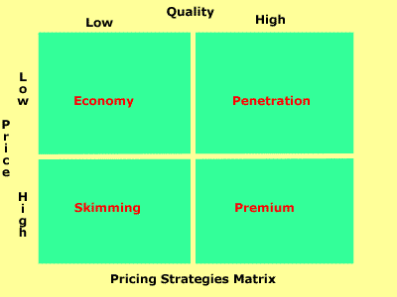
PRICING STRATEGY
.
Economy Pricing
This is a no frills low price. The cost of marketing and manufacture are kept at a minimum.
Penetration Pricing
The price charged for products and services is set artificially low in order to gain market share. Once this is achieved, the price is increased
Premium Pricing
Use a high price where there is a uniqueness about the product or service.
Price Skimming
Charge a high price because you have a substantial competitive advantage. However, the advantage is not sustainable. The high price tends to attract new competitors into the market, and the price inevitably falls due to increased supply.

Slide 113
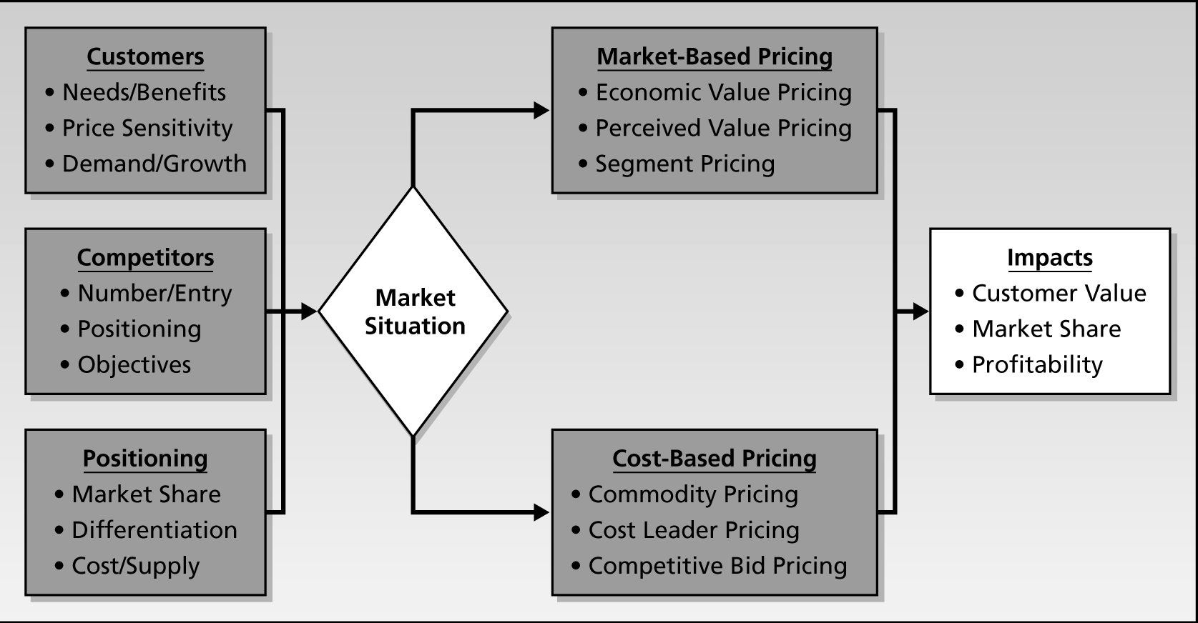
Pricing Strategy Process Template

Slide 114
Price and Perceived Value: The Economic Perspective
Perceived
Benefits
Objective
Price
Perception
of Price
Perceived
Value
Willingness
to Buy
Perceived
Costs
So, according to the economic perspective, consumers will purchase whenever
Perceived Value > 0

Slide 115
Price and Perceived Value: The Economic Perspective
Objective Value
Marketing
Efforts
Perceived Value
Price of
Substitutes
Consumer’s Incentive to Purchase
= [Perceived Value – Price]
Product Price
Firm’s Incentive to Sell
= [Price – COGS]
Cost of Goods Sold
$0
Cost of : Raw Material, R&D, Labour Cost, Packaging, Overhead

Slide 116
Pricing Decision Process
maximize sales revenue
maximize profits
maximize growth
market skimming
product quality leadership
1. Selecting the pricing
objective
2. Determining demand
3. Estimating costs
4. Analyzing competitors’
costs, prices, and offers
5. Selecting a pricing
method
6. Selecting final price

Slide 117
PRICING AND COST OF THERAPY
PRICE PER COUNT UNIT
X
DOSAGE
X
DURATION OF THERAPY
COST OF THERAPY

Slide 118
PLACE AND DISTRIBUTION STRATEGY
PRODUCT - SPECIALTY MAPPING
POPULATION
DOCTORS
SCREENING AND SELECTION
HOSPITALS
DISTRIBUTION COVERAGE
PHARMACIST
CUSTOMERS LIST
CUSTOMERS COVERAGE
DRUGSTORE
MARKET AREA COVERAGE
PATIENTS
CALL MANAGEMENT
SOLE DISTRIBUTOR AND MULTIPLE DISTRIBUTOR

Slide 119
CUSTOMERS LIST OF PRODUCTS
Based on :
 Specialization a of the Product’s Target Doctors
 Indication of the Products
 Economic Class and Number of Patient
 Drugs Indication versus Doctors Specialization

Slide 122
Plan Assumptions
Aspects | Assumptions
FINANCIAL
* Cost | Annual cost increases based on inflation 6%
* Product Price | No price increase in 5 years plan
PRODUCT
* Registration/Approval | Expected February
* Product Performance | New Clinical trial results on dosage reduction expected by june
LEGISLATION
* Price Control | None expected
* Others | Generic Act implementation will not materialise next year

Slide 123
Plan Assumptions
Aspects | Assumptions
PERSONNEL
* Field Forces | Based on full complement of 100 reps
COMPENTITIVE ACTIVITIES
* Competitive Launch | None expected until 2 years later

Slide 124
CONTIGENCY PLANNING
Assumption | What if? | Probability of occurrence | Likely Impact | Action
Price increase of 10% will be allowed in June | What if only obtained 7%? | 50% | Will have <$300K less revenue | Will cut down advertising and gimmicks by $75K and launch new form earlier to preserve net income as planned

Slide 125
CONTROL SYSTEM
develop program control template and updated
monthly – quarterly – annually

Slide 128
PROFIT AND LOSS
ANALYSIS-PROJECTION

